Slide 1




BrighterBee
Droidrush Avishkar 2020
By NP Devs

Slide 2

The problem
1
Students/ Learners/ Enthusiasts have less platforms dedicated for them to discuss and share their ideas.
2
The existing platforms lack the intuitiveness in UI which is needed and have a steep usage learning curve.

Slide 3
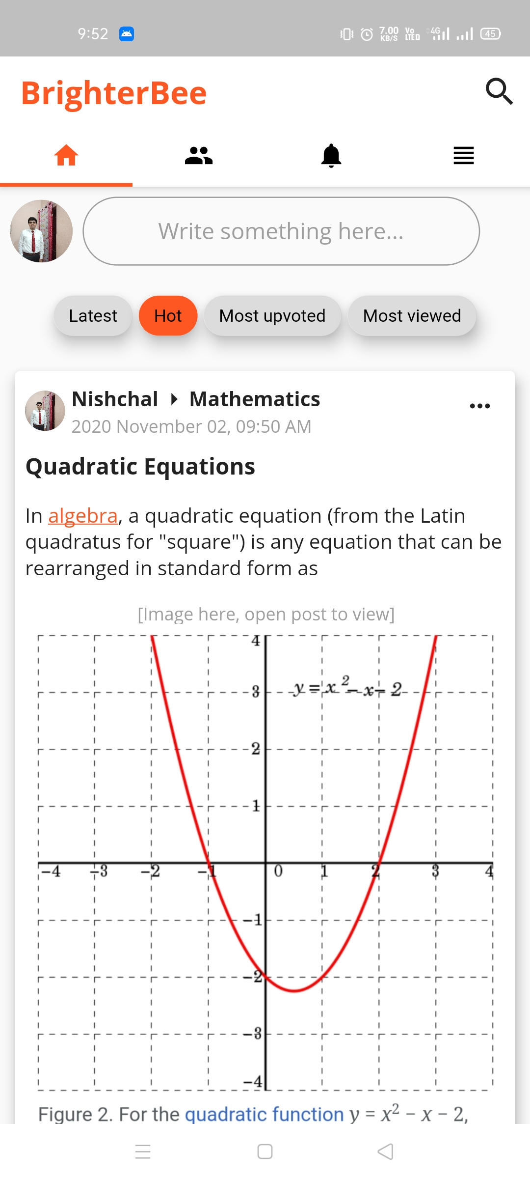
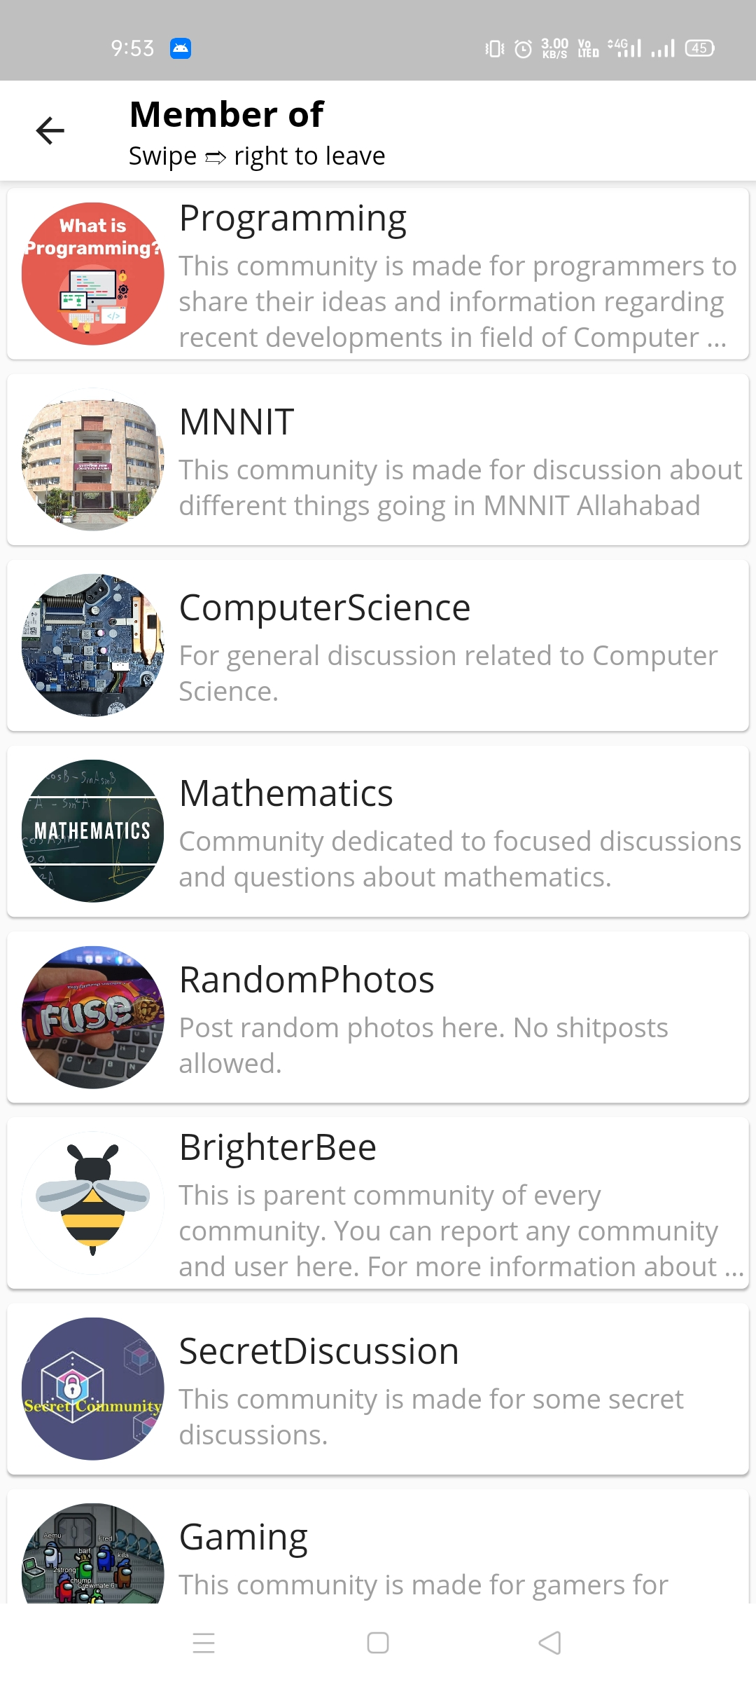
Slide 3
What we made
User maintained communities.
Feed as per user’s choice.

Slide 4
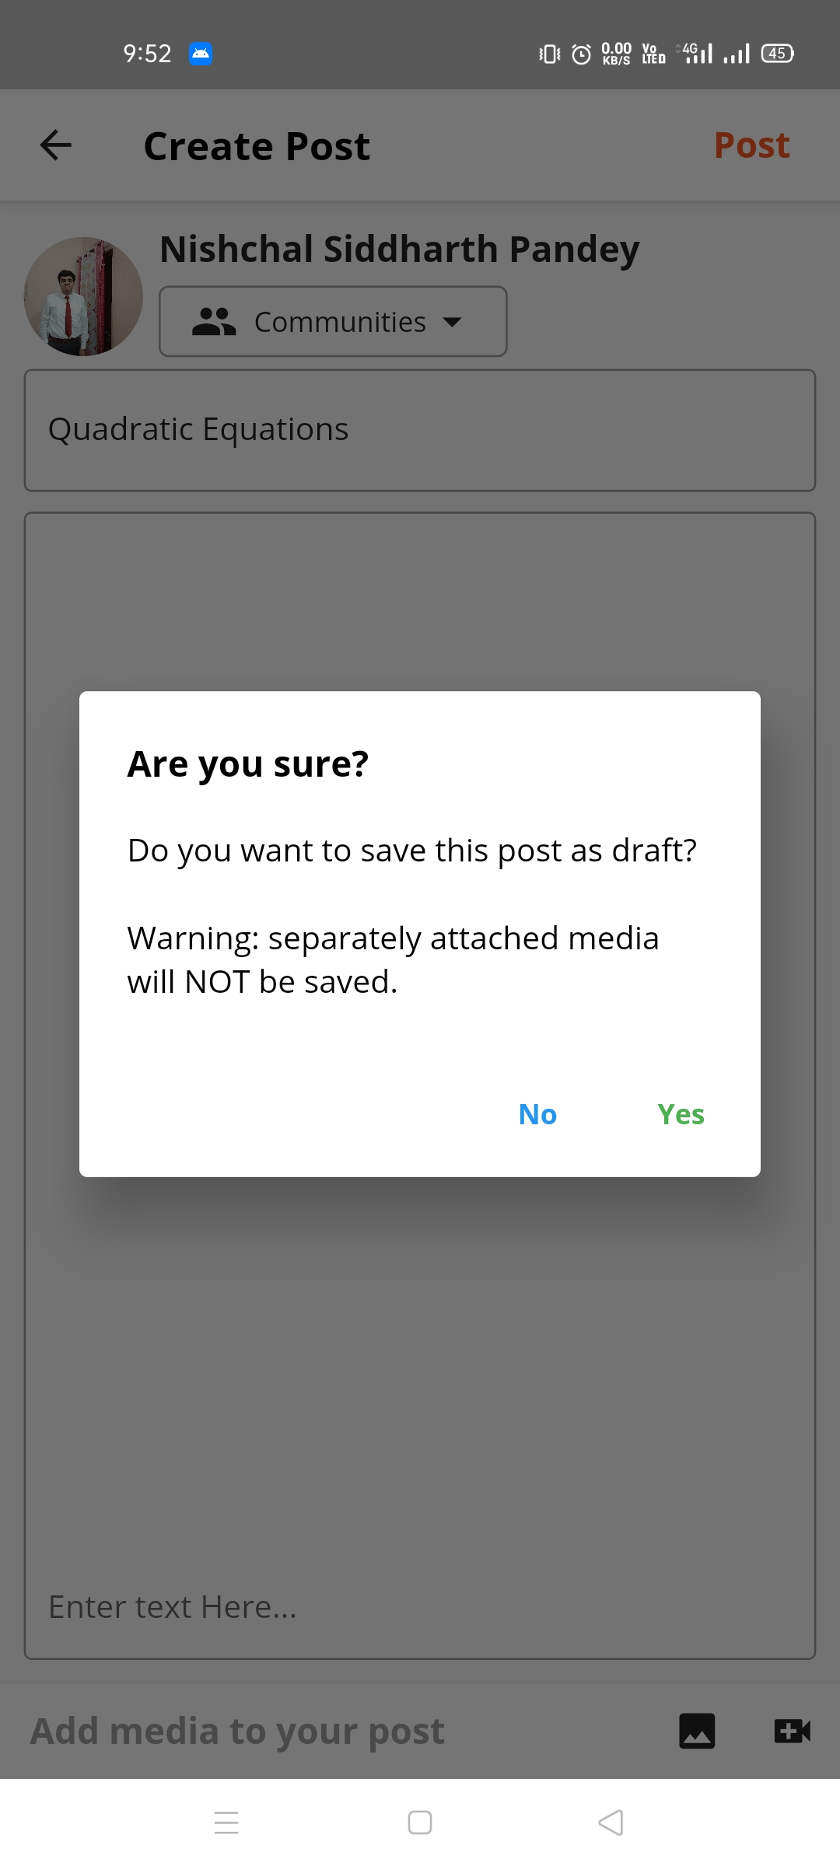
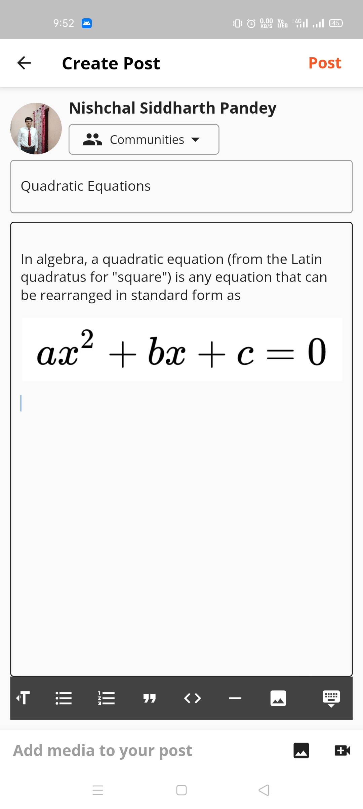
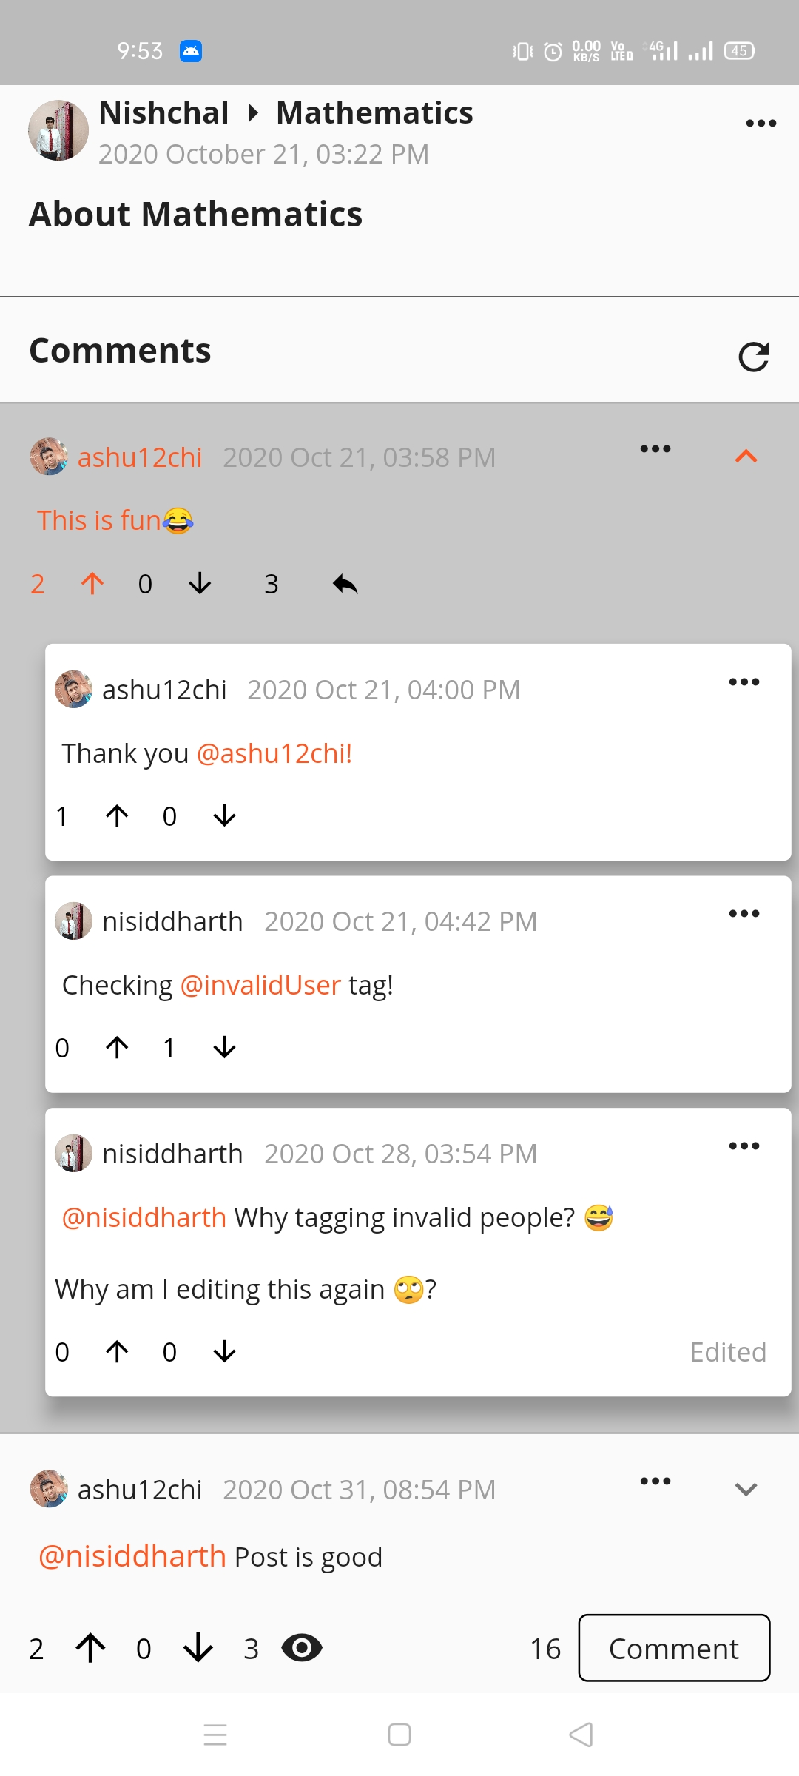
Or save as draft and complete it later.
Type the post in Rich Text and post it.
Like the content? Upvote it or discuss on it!
Notes:
When conducting research, it is easy to go to one source: Wikipedia. However, you need to include a variety of sources in your research. Consider the following sources:
Who can I interview to get more information on the topic?
Is the topic current and will it be relevant to my audience?
What articles, blogs, and magazines may have something related to my topic?
Is there a YouTube video on the topic? If so, what is it about?
What images can I find related to the topic?

Slide 5
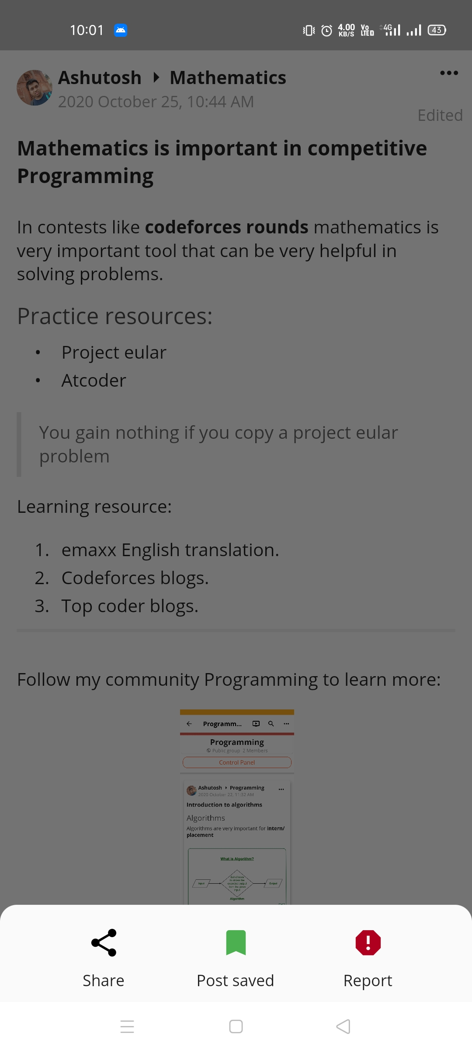
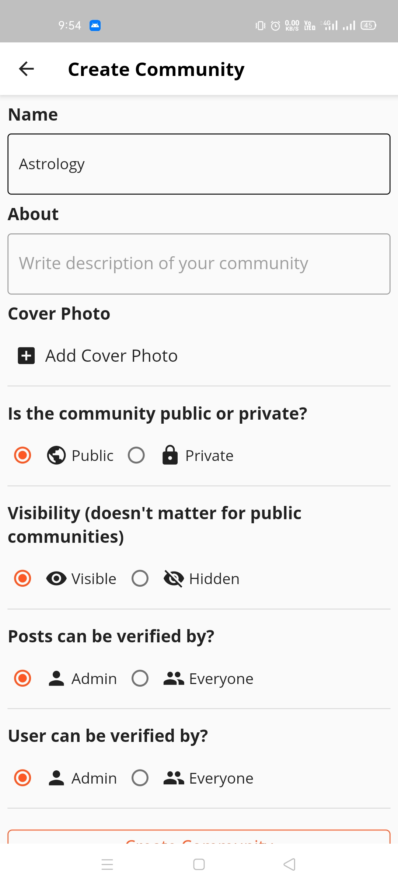
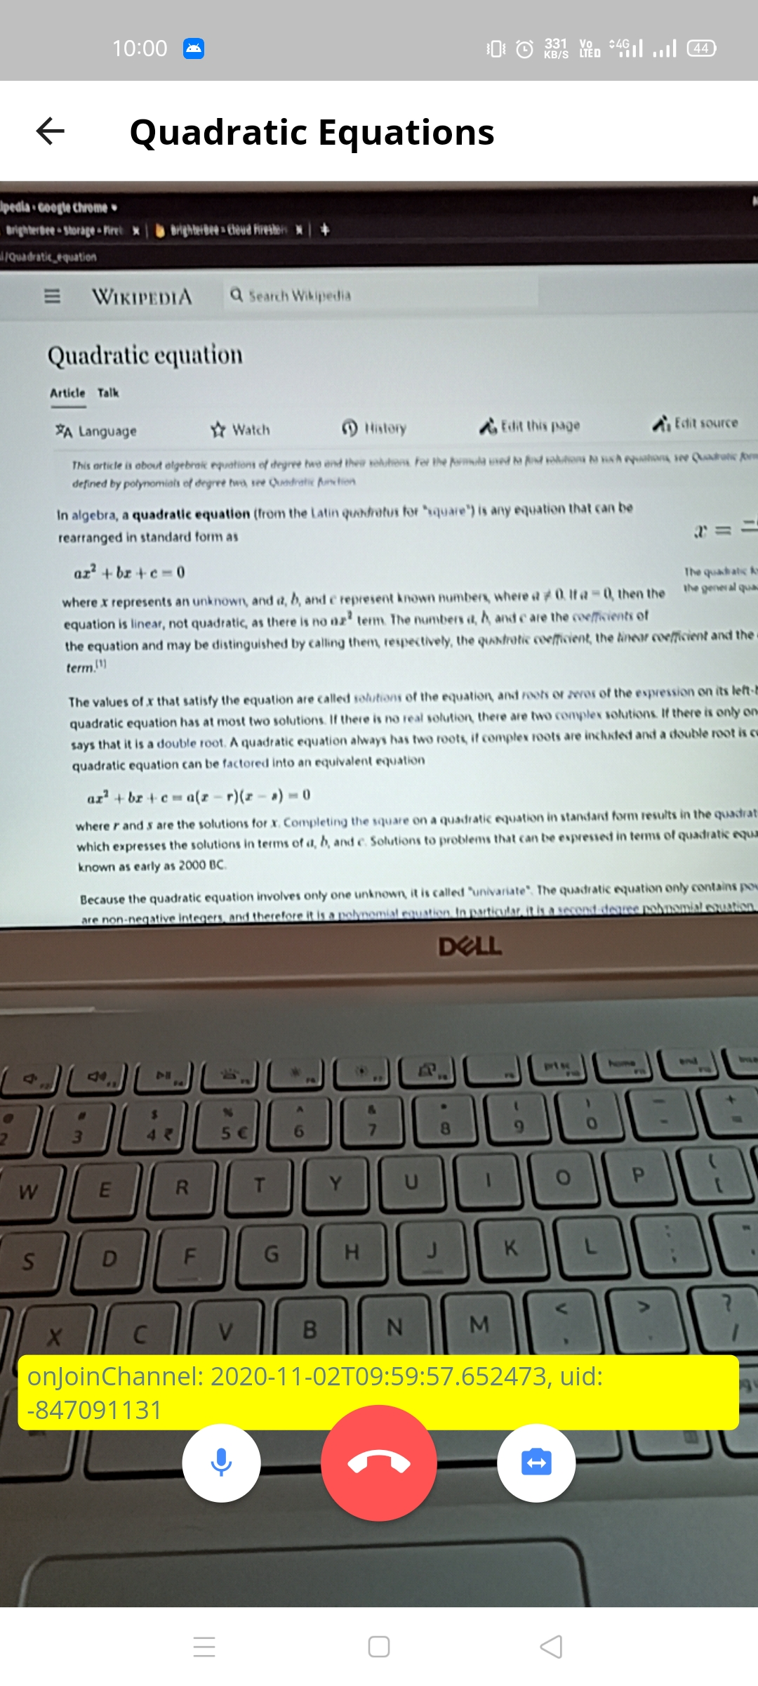
Have more insights? Share it to others live!
Not satisfied with existing options? Start your own community!
Found it useful? Save to read it later.
Love the post? Share it to friends.
Hate it? Report it.
Notes:
Once you find your sources, you will want to evaluate your sources using the following questions:
Author:
Who is the author?
Why should I believe what he or she has to say on the topic?
Is the author seen as an expert on the topic? How do you know?
Current:
How current is the information in the source?
When was the source published?
Is the information out-of-date?
Accuracy:
Is the content accurate?
Is the information presented objectively? Do they share the pros and cons?

Slide 6
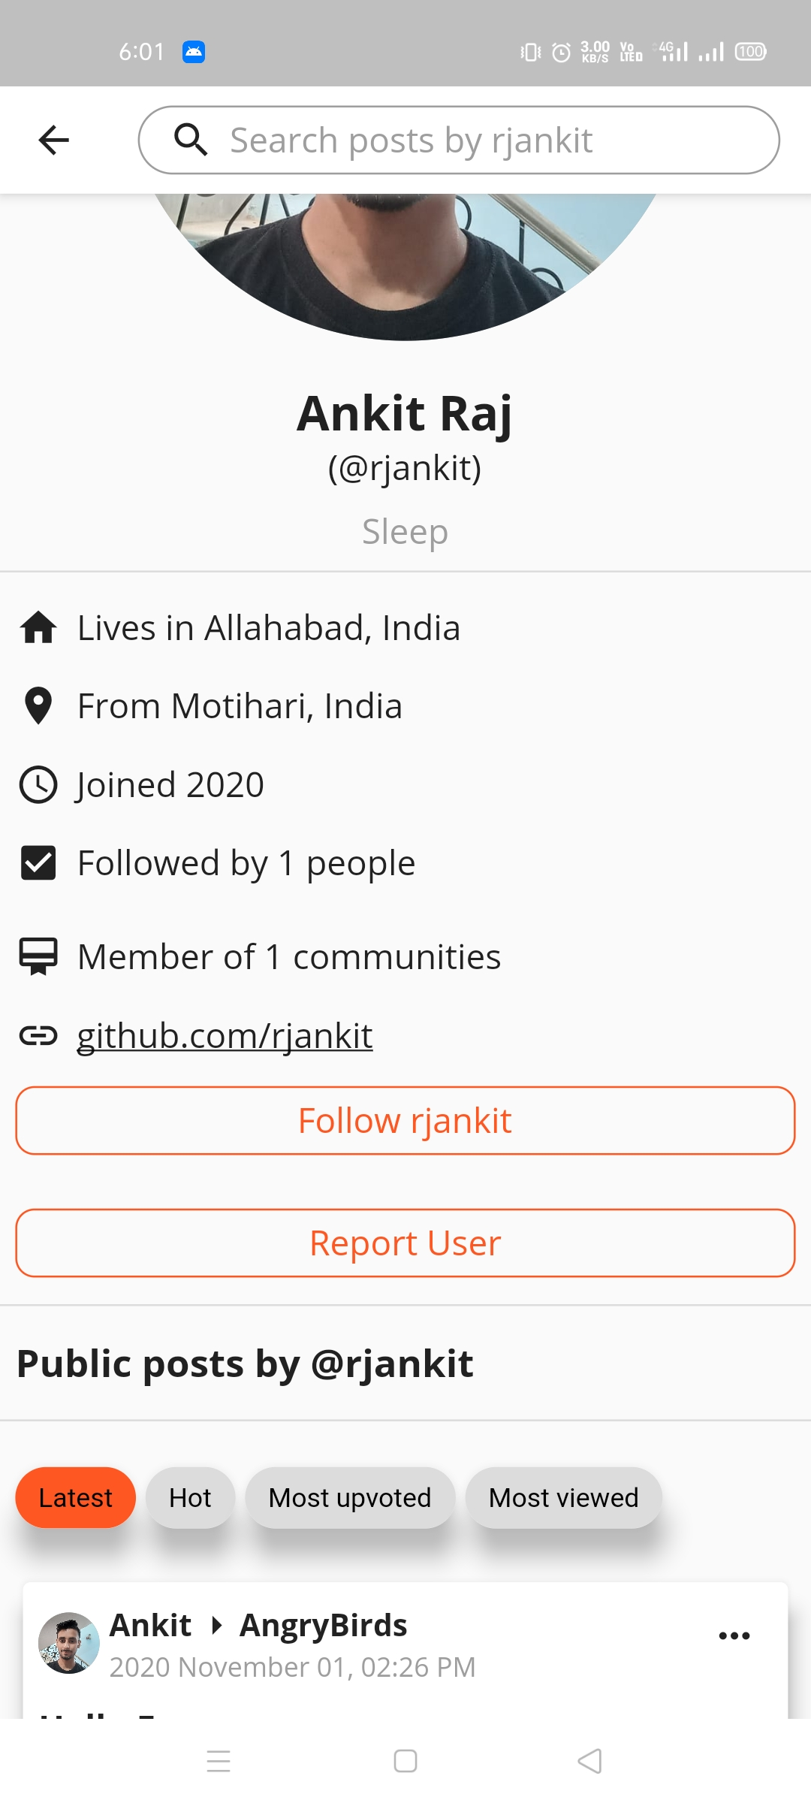
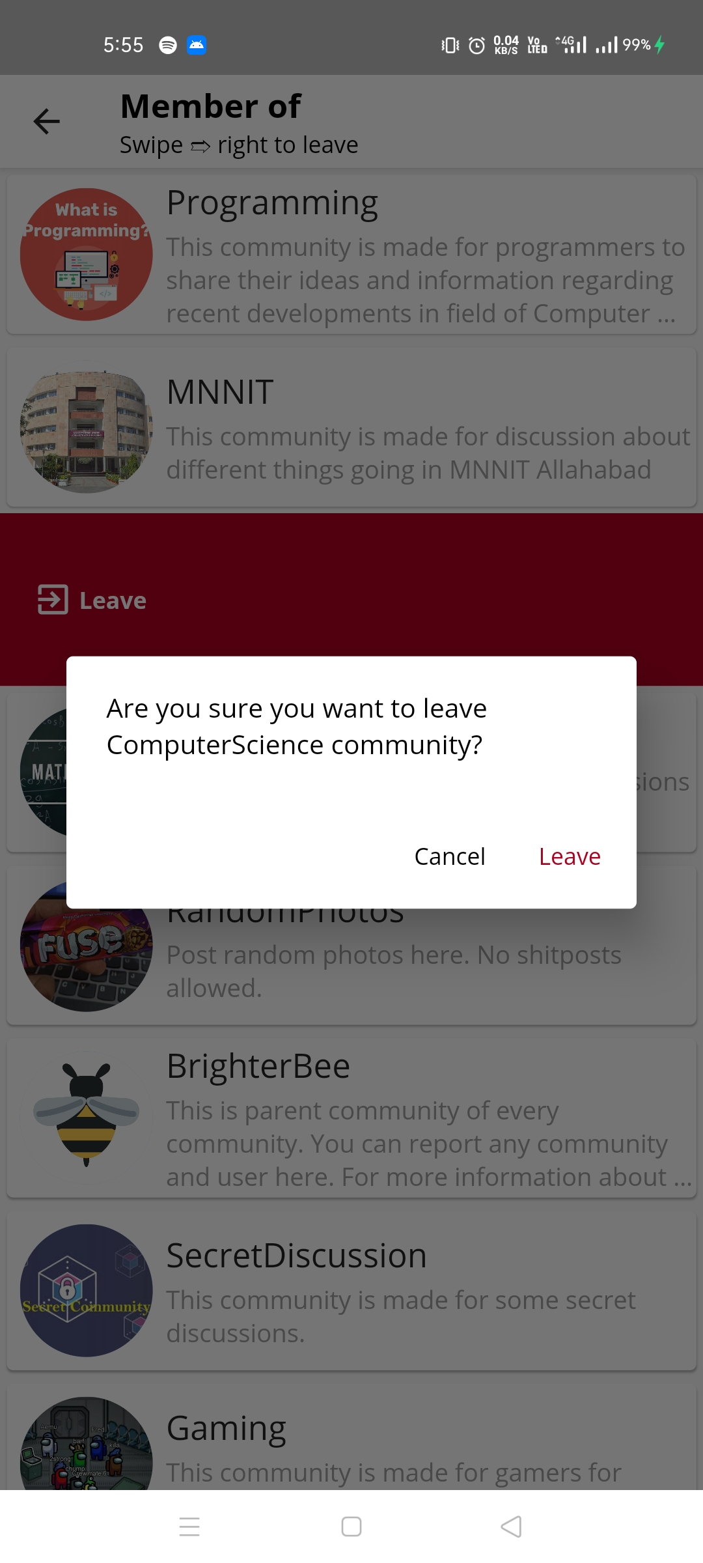
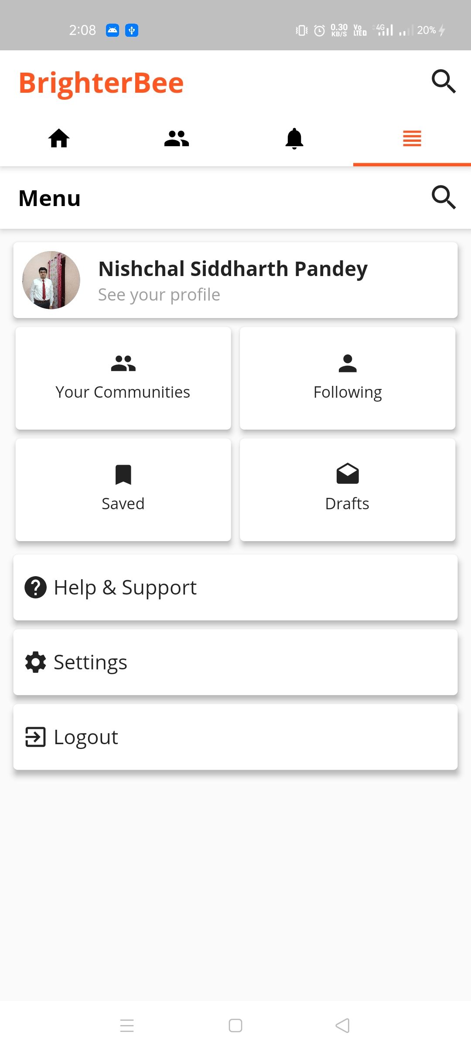
More options covered.
Leaving community, unfollowing users, handling reports all can be done with simple swipes.
Want to view other user’s details and posts or edit your own details?
Profile has got you covered.

Slide 7
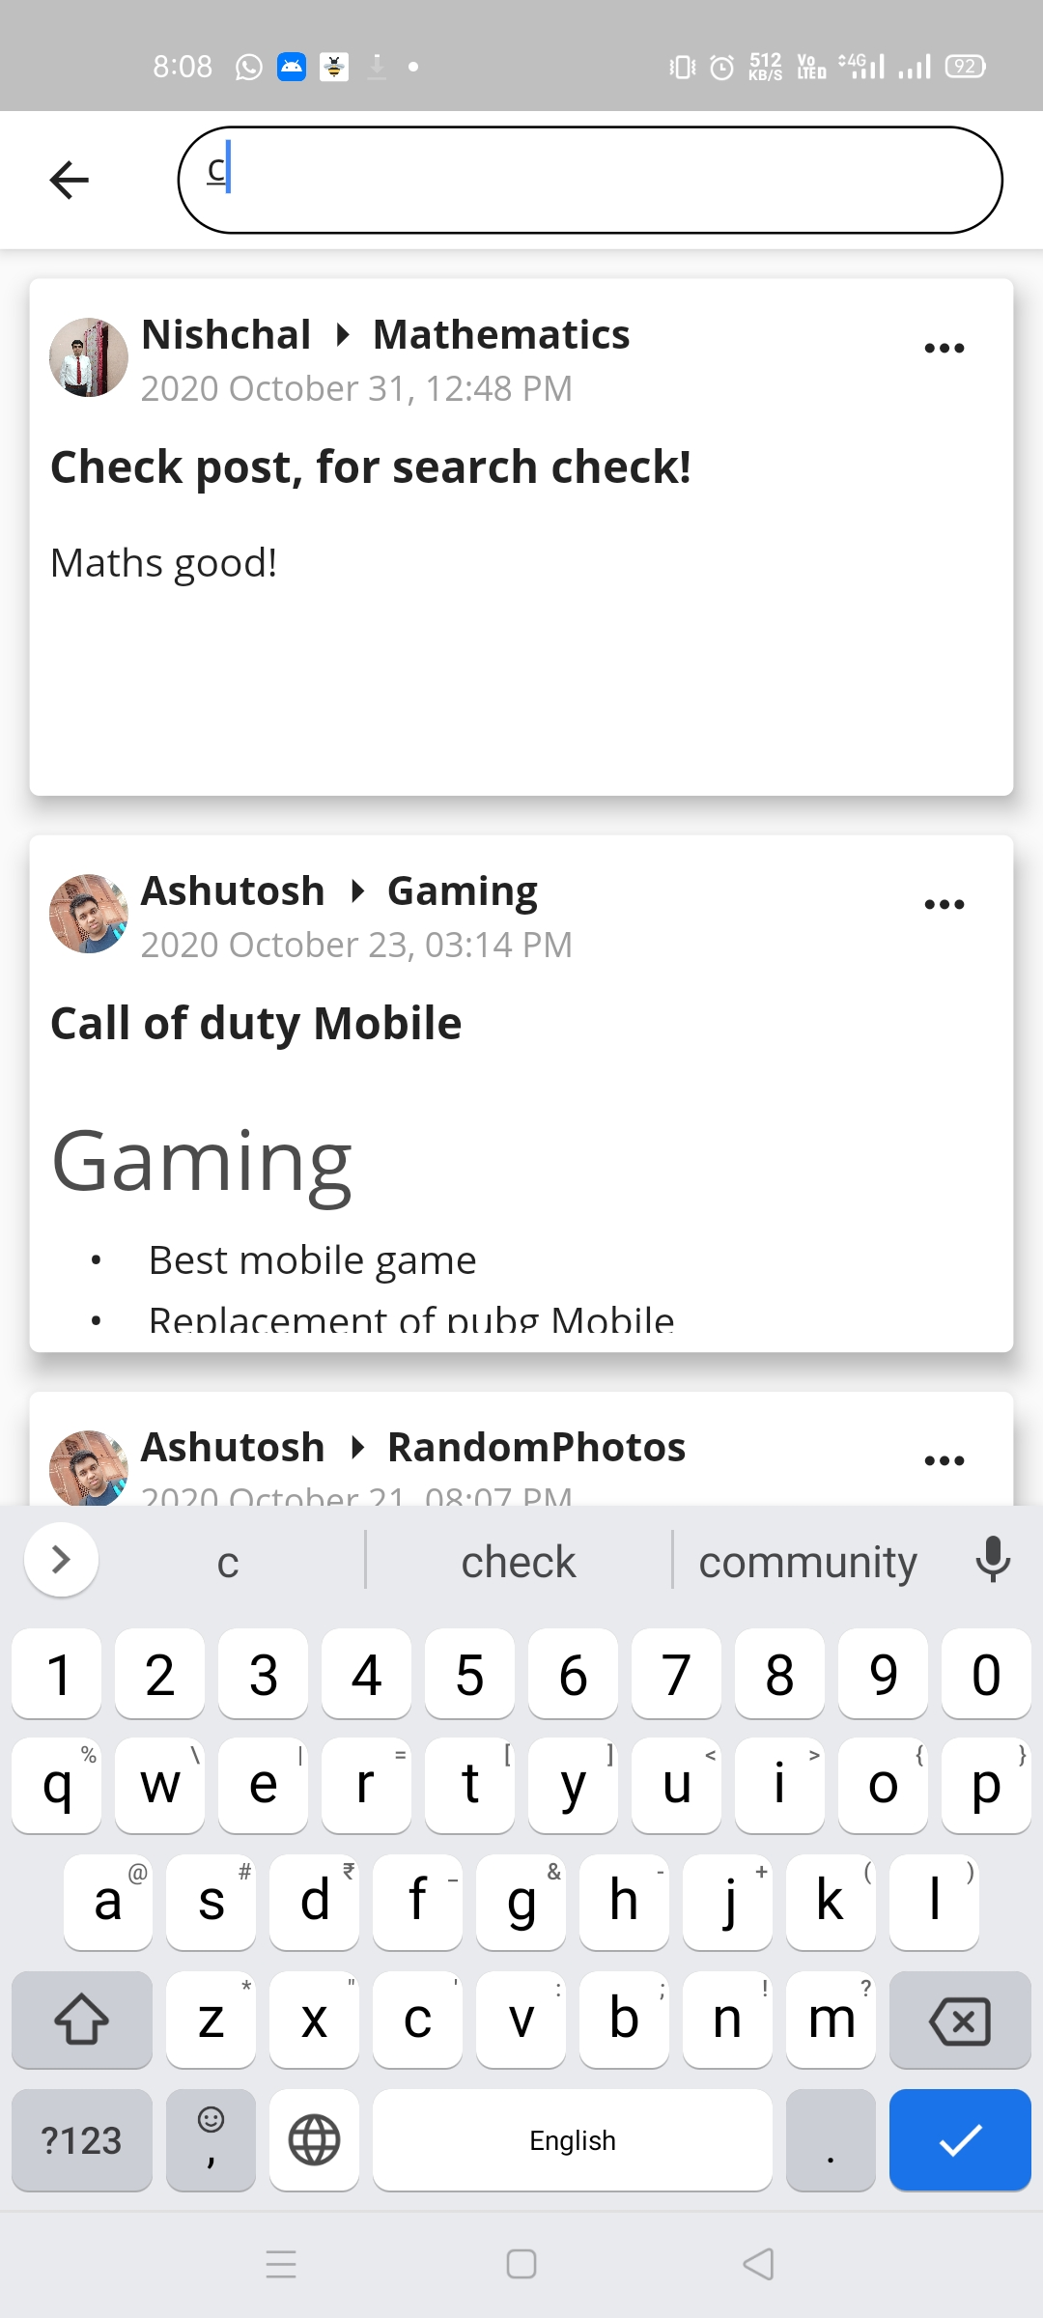
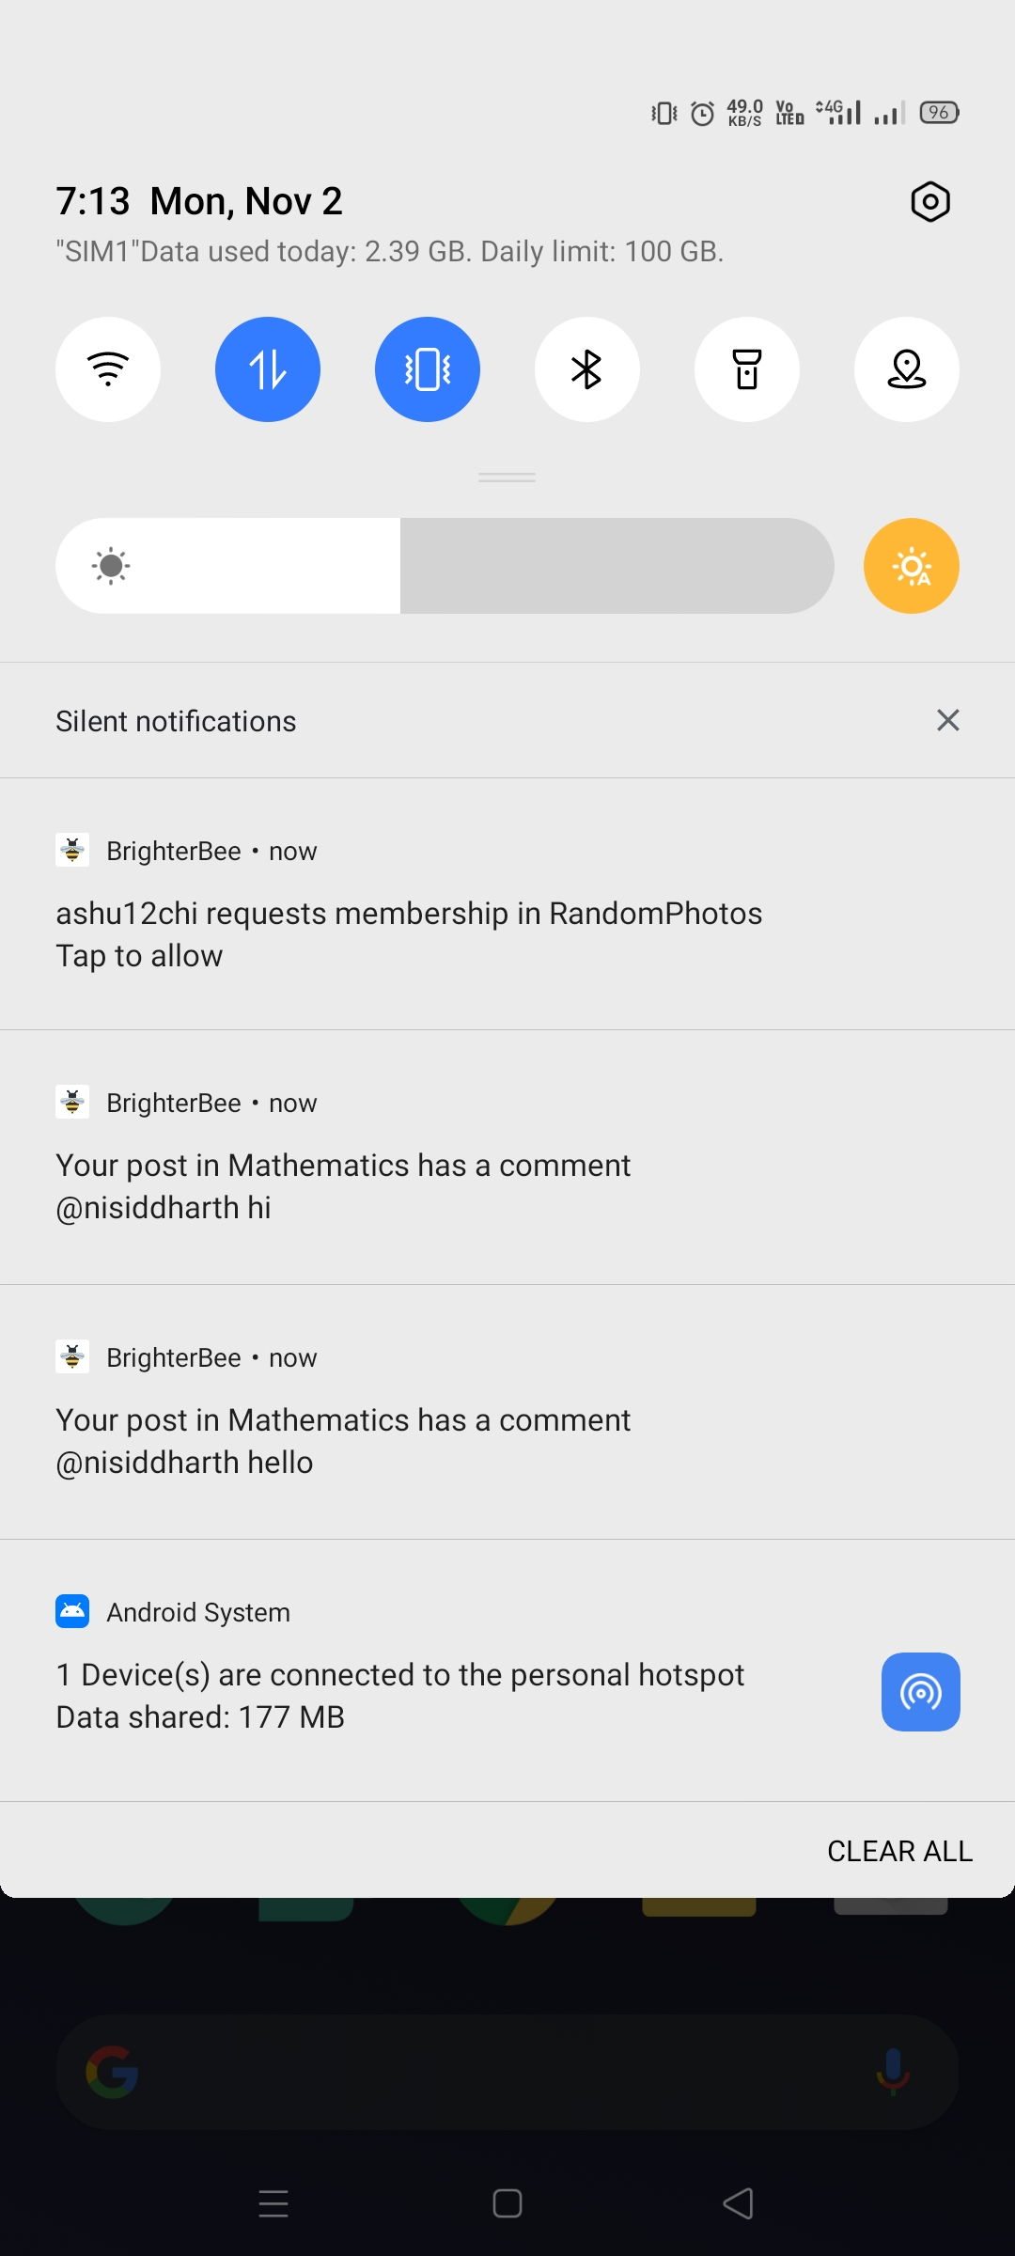
Posts, communities and users can be searched using separate search bars.
User verification, post verification, user follow all send push notifications according to need.

Slide 8
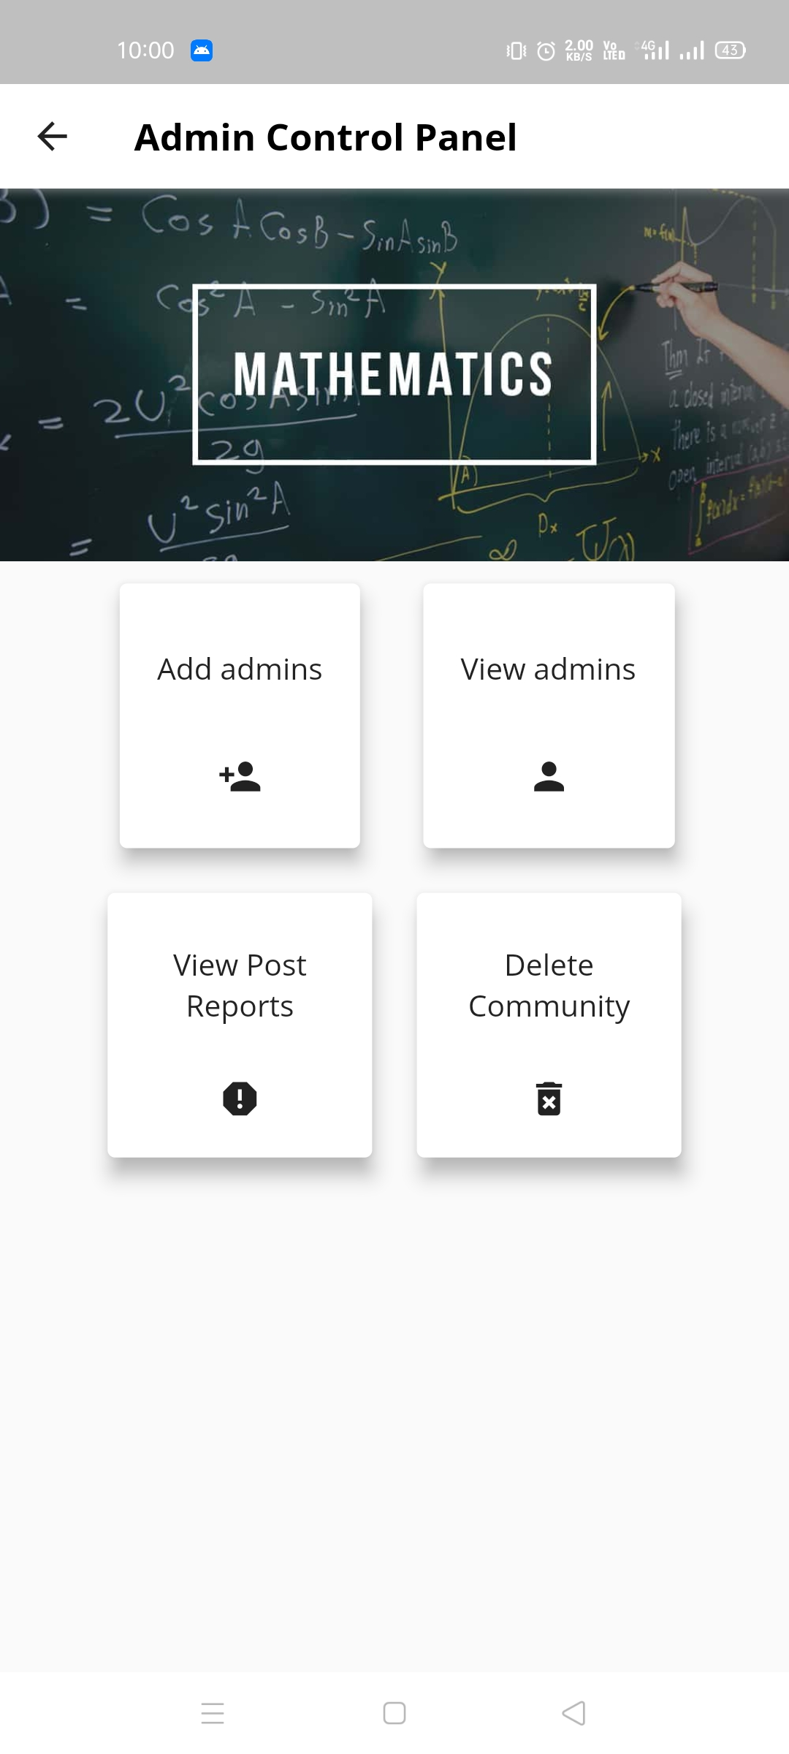
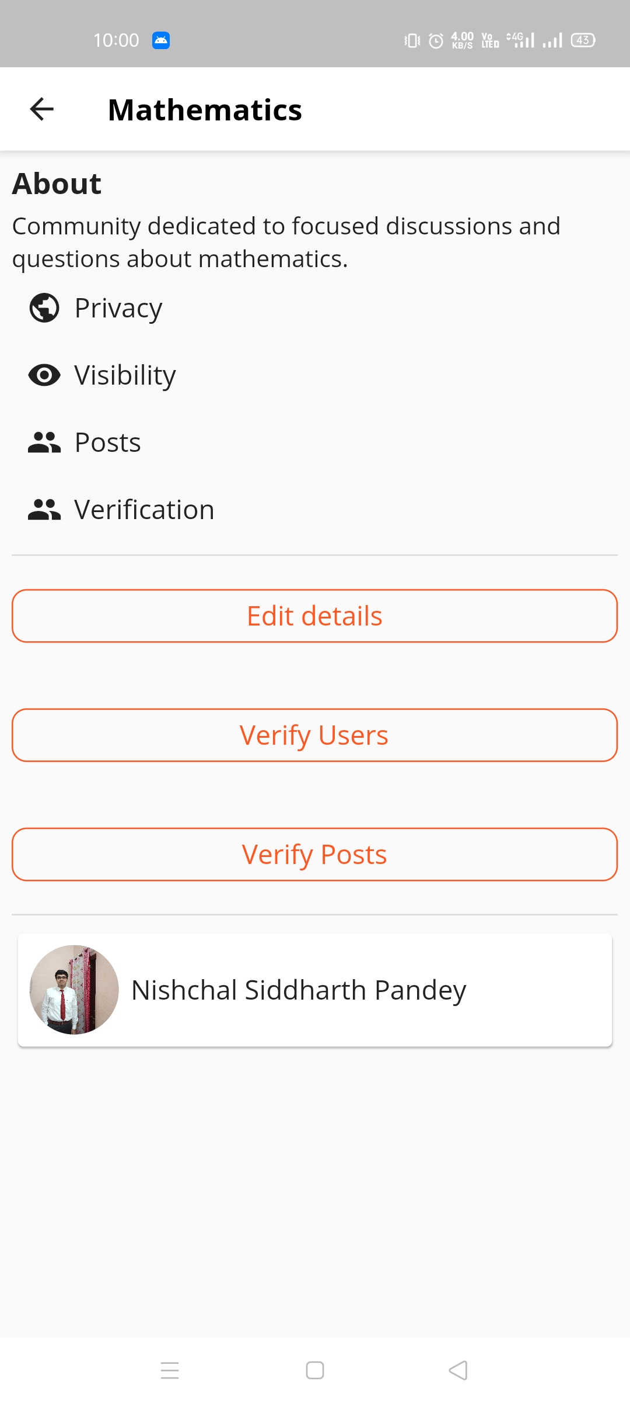
If you are an Admin, you can do the following
Make others Admin
Manage existing Admins
Modify the community, set its rules.
Manage the post reports
Manage user join requests
No longer needed, delete the community.
Verify new posts!
[Only community creator can delete a community]

Slide 9
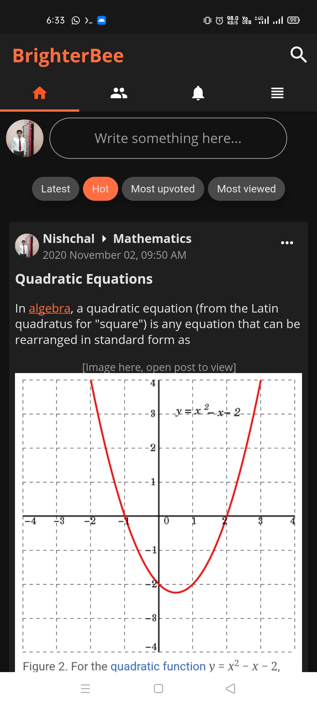
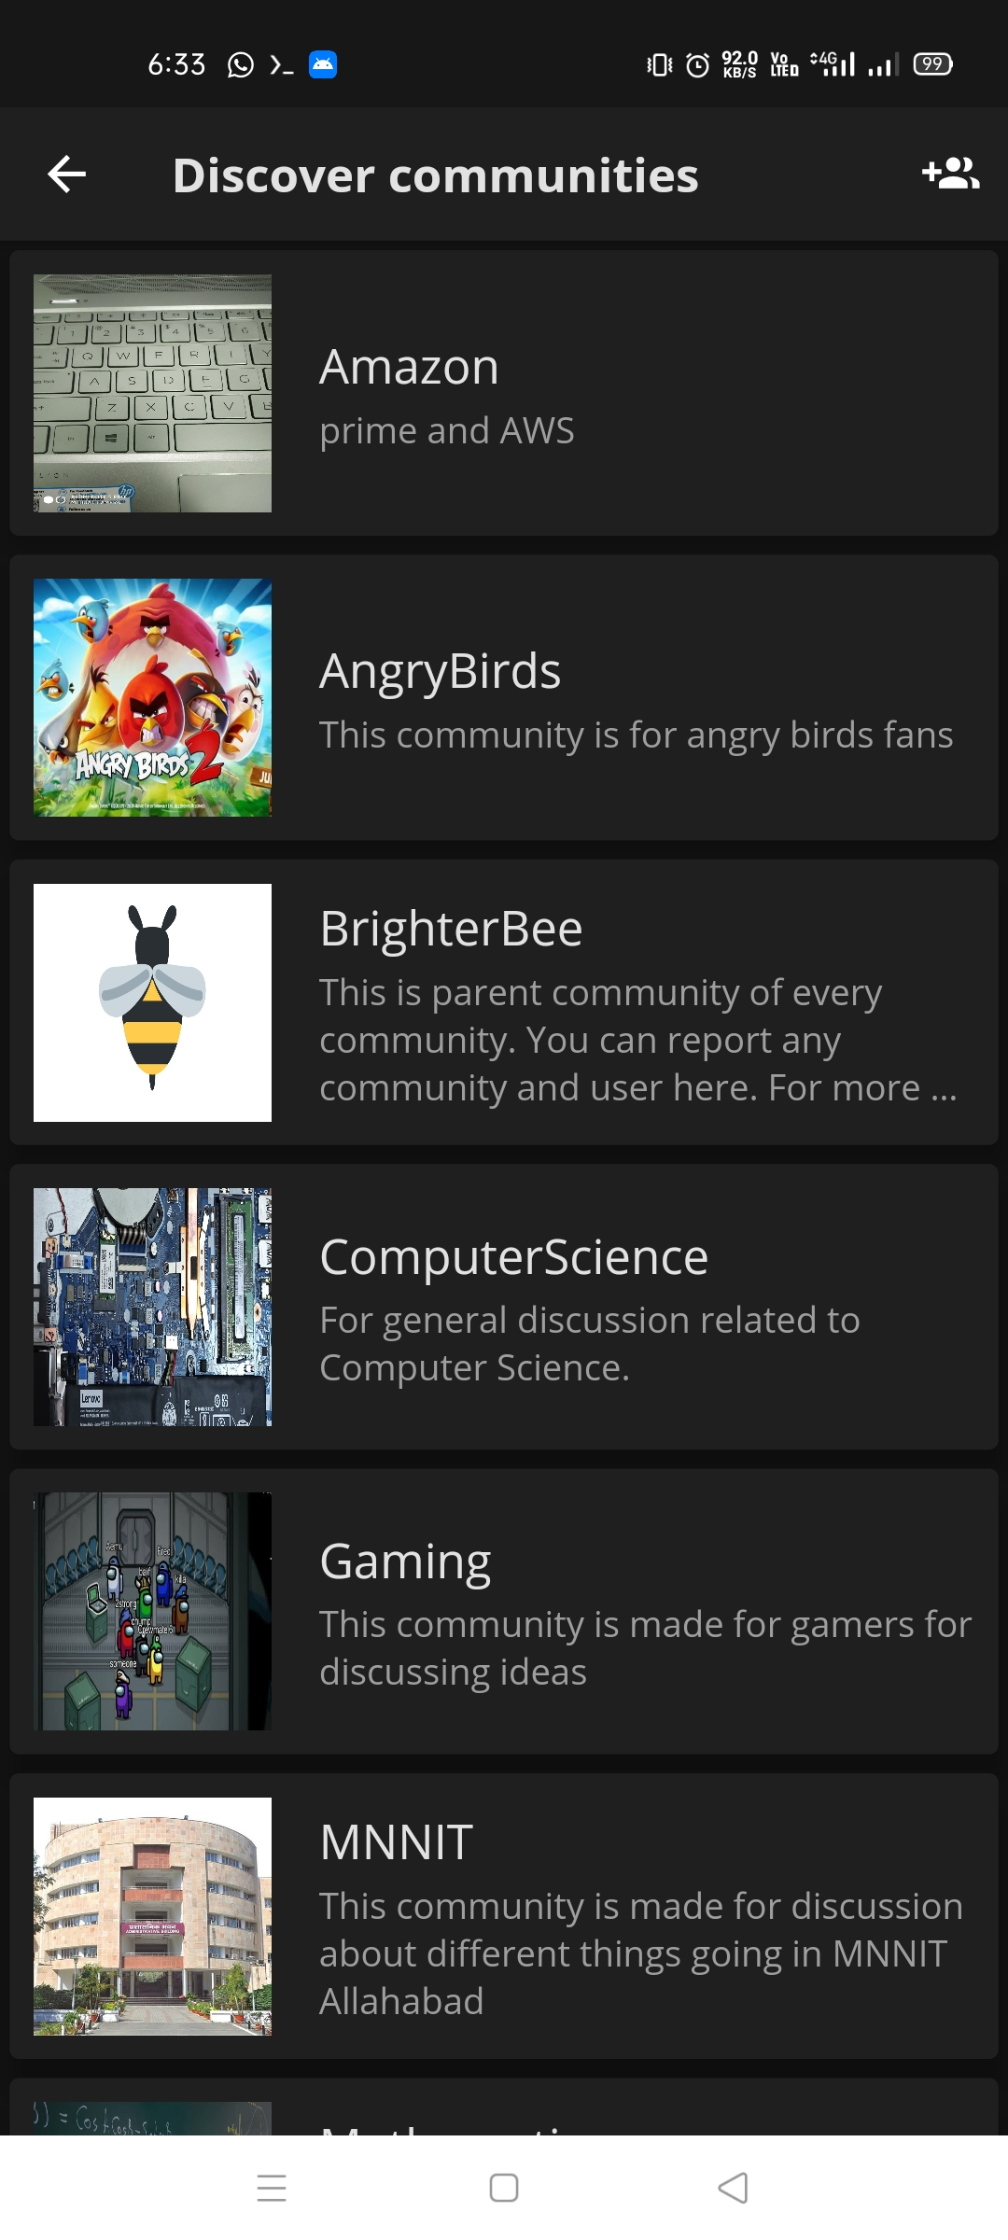
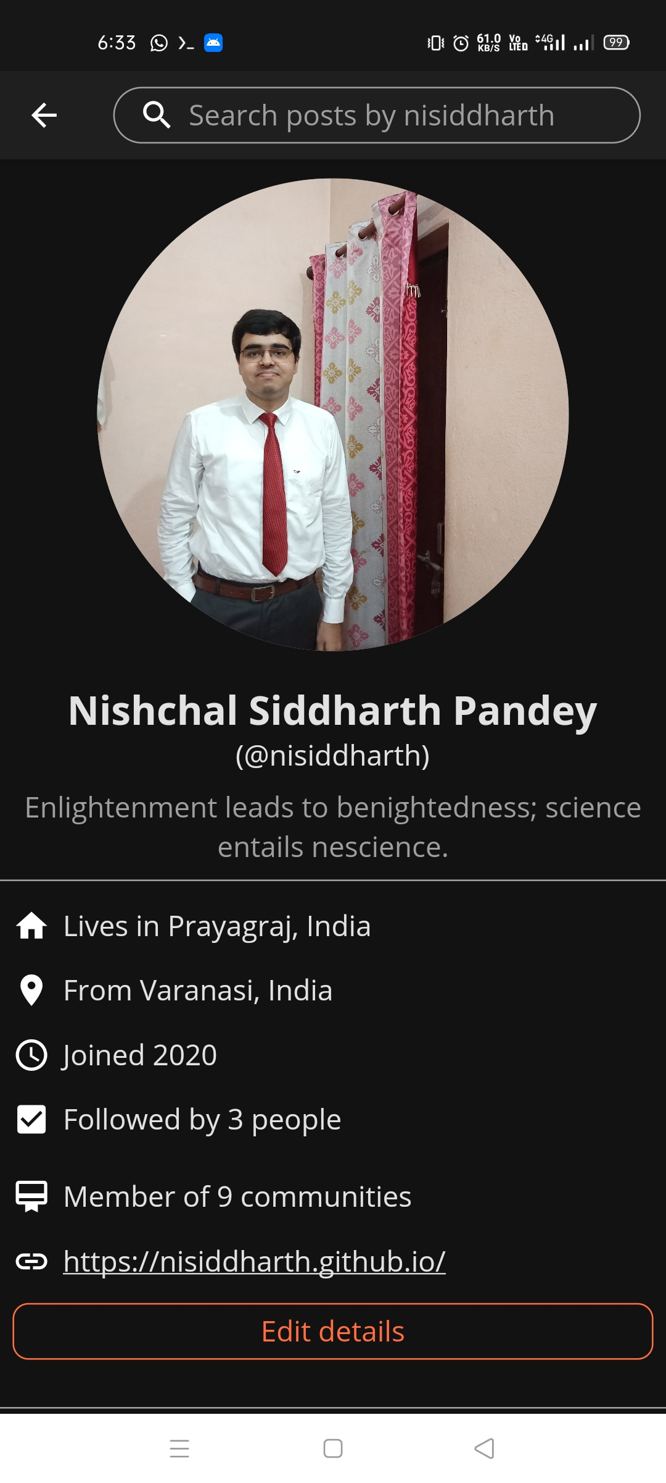
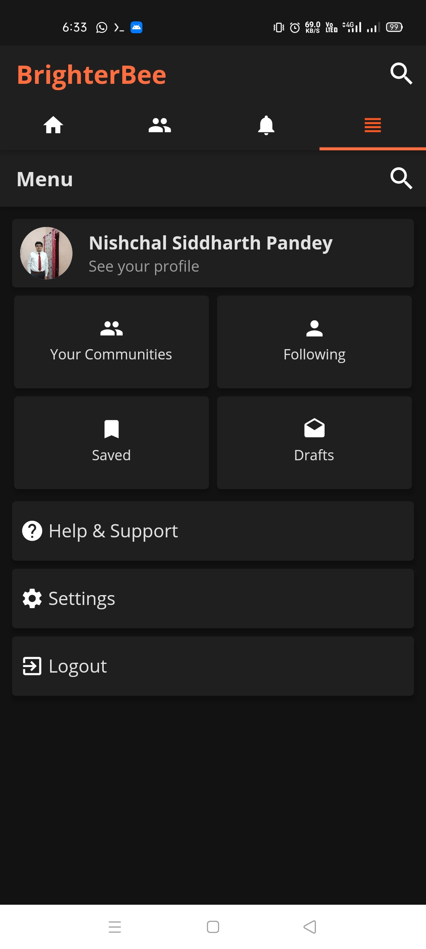
The app has full dark theme too

Slide 10
What we used
Tech stack
Flutter SDK
Dart programming language
Typescript
APIs
Components
Firebase Auth for login authentications.
Cloud Firestore and Firebase Storage for storing all user data, posts and comments.
Agora RTC Engine for video streaming.
Firebase Cloud Messaging for push notify.
rxdart for managing firebase streams.
Quill delta for editing Rich Text
NotusToHtml for sharing posts as web links.
Zefyr Editor, for rich text editing toolbar.
Chewie for playing media in posts.
CachedNetworkImage for faster loading of images the next time.
PhotoViewer for zoomable and pannable images.
Notes:
Now, that you have narrowed your topic, you will want to organize your research in a structure that works. There are some common organizational patterns based on the kind of research you are doing.
Organizational Structures:
Cause and Effect- this kind of structure is great for explaining the causes and effects of a topic
Compare and Contrast- in this pattern you highlight the similarities and differences of the topic
Explain process- this structure is great for outlining a series of steps to follow;
Definition- if you want to make sure your audience understands what something is using illustrations, meanings, clarifying misconceptions, you may want to use this structure
Classification- a common organizational structure is grouping like topics or facts from the research together. For instance, in the internet safety about social media apps, you may organize the research where you look at each social media app one at a time

Slide 11
Who can use our App?
Just everyone. Whosoever wants a community of people online to talk to and share ideas is a possible customer of our product.
What to expect in future?
ML powered feed generation.
Sponsorship of content and posts.
Donating/ awarding to post creators.
Notes:
After consulting a variety of sources, you will need to narrow your topic. For example, the topic of internet safety is huge, but you could narrow that topic to include internet safety in regards to social media apps that teenagers are using heavily. A topic like that is more specific and will be relevant to your peers. Some questions to think about to help you narrow your topic:
What topics of the research interest me the most?
What topics of the research will interest my audience the most?
What topics will the audience find more engaging? Shocking? Inspiring?

Slide 12
Our team
Ashutosh Chitranshi
Nishchal Siddharth Pandey
Anushka Srivastava
Get BrighterBee now:
https://github.com/NPDevs/BrighterBee/releases
Thank you!
Notes:
After you’ve done your research, it’s time to put your presentation together. The first step in the process is to introduce the topic. This is a great time to connect your topic to something that your audience can relate. In other words, why should they listen to all the information you will be sharing in your research presentation? What is in it for them? You may also want to include a graphic or image to grab their attention.
Feel free to duplicate this slide by right-clicking on this slide in the slides pane to the left and select Duplicate Slide.
The next step in your presentation is to state your claim or topic clearly. Your teacher may even call this your thesis. As you state your thesis, you may find that this layout is not the best layout for your claim or topic. You can change the layout by clicking the drop-down menu next to the Layout in the Slides menu section. You can choose Two Content, Comparison, or Picture with Caption. Note: A different layout might change the look of the icons on this page.
You will also want to state your facts. You have done the research now share some of the interesting facts with your audience. Facts do not have to be boring; you can communicate facts in a variety of ways by going to the Insert Tab. In the Insert tab you can:
Insert pictures from your computer or online.
Add a chart
Create some SmartArt
Insert a variety of icons to help your facts come to life. Note: You can change the color of the icons by selecting the icon and then click on the Format tab and then Graphics Fill. From there, you will choose a color from the list or choose More Fill Colors to give you more options.
Since this research presentation is a result of your hard work and searching, you want to make sure you support the claims or points in your presentation with facts from your research findings. Make sure you give the author proper credit for helping you share your ideas. If one of your sources has a video that is relevant to your topic, you can add the video as added support. Keep in mind the length of the video and the amount of time you have for your presentation. For a 5 minute speech, the video should be no longer than 30 seconds.
Questions to consider:
How will you state the author of the source?
Will you need to cite the source on the slide?
What are some ways you can engage your audience so they feel like they are a part of the presentation? Some ideas to consider is by taking a quick poll like: by a show of hands, how many of you think school uniforms are a way to cut down on bullying? Another suggestion is to have them hold up a certain number of fingers to see if they agree or disagree. Finally, you can share a story that the audience can relate to that makes them laugh.
After all the applause, your audience may have some questions. Be prepared to answer some of their questions by making a list of questions you think they might ask. You may also want to share the presentation with them by providing the link to your presentation, if they want more information.

